Slide 1
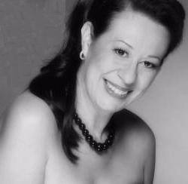
SISSI ABREU
Brazilian Soul Jazz Band
Notes:
Sissi Abreu

Slide 2
Overview
A celebrity in her native country, Brazil, Sissi Abreu, brings the best of traditional and modern Brazilian jazz and world music to the US. This is the real deal. From classic Bossa Nova to rousing Samba, her unique voice and spirit will touch your heart and make you want to dance. She her self is a professional dancer and choreographer bringing spice to the scene of music and dance, and she knows that the barrier of language is nothing when you work with the heart. Sissi did her first steps at age 4, enjoy the best dance schools in brazil , start singing professionally in Sao Paulo at 17. In a career spanning more than 20 years, she has worked with some of the best names in Brazil, as a songwriter and arranger, fronting small combos and big bands, famous choreographers, on stage and in the studio. Sissi believes that art is a soul and heart, the best way to express our self's

Slide 3
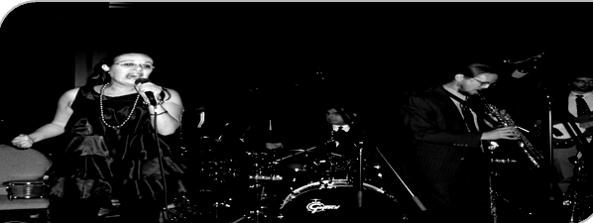
Features
Sissi Abreu Arrangements & voice
Lonnie Walsh Arrangements & Semi Acoustic Guitar
Brazilian Soul Band Instruments & performance
Marcos Serra Studio Production

Slide 4
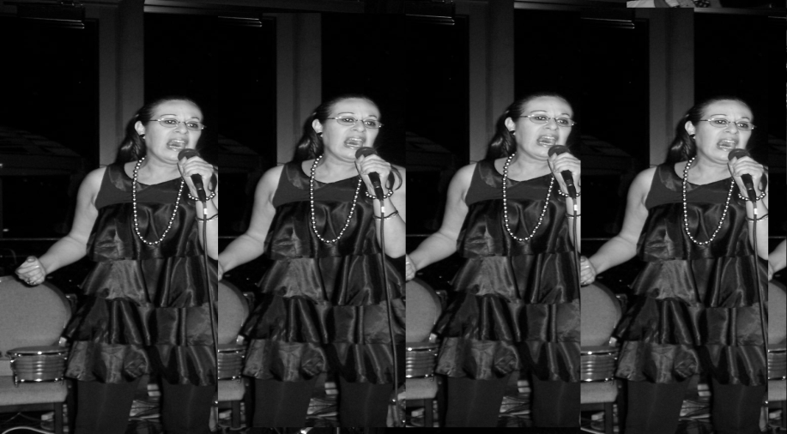
Applications
Our band was design for perform in a variety of Artist Environment
Jazz Clubs
Clubs
Cruises
theaters
Casinos
Resorts
Festivals
City Parks
Any Place at our music can bring a touch of spice in peoples life's

Slide 5
Pricing
The product available and listed specifically differed in price for each single event and additional perform.
The company Forum Arts have options in prices upon approval of the Booking Agent & Manager

Slide 6
Availability
List available upon schedule
Phone 720 545 4625
Fax 239 243 0136
Email forumartisinc@gmail.com
Web www.forumartsinc
Thanks
Forum Art Inc
Notes:
Forum Arts

